Slide 1
Chapter7
Systems of Particles

Slide 2
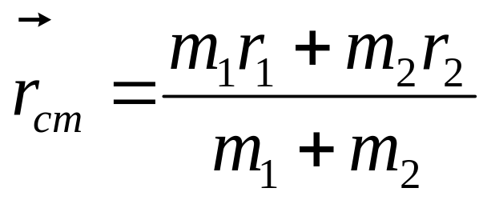
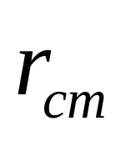
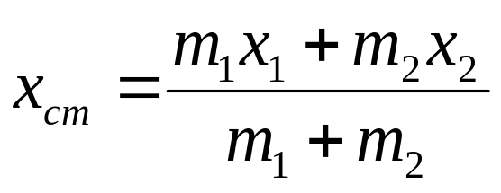
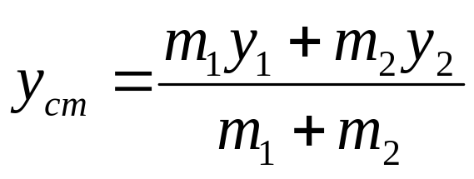
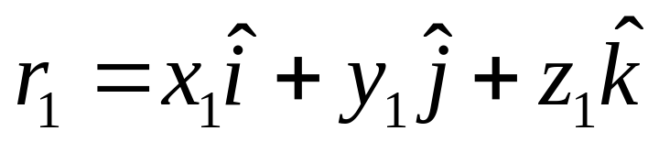
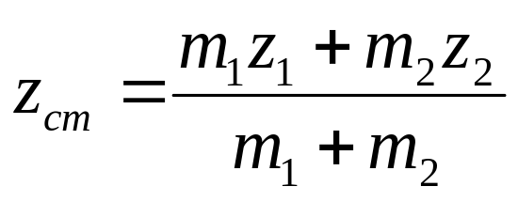
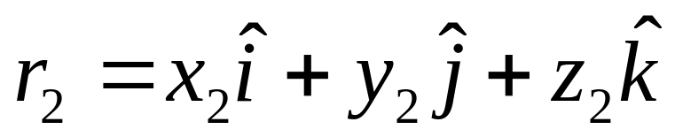
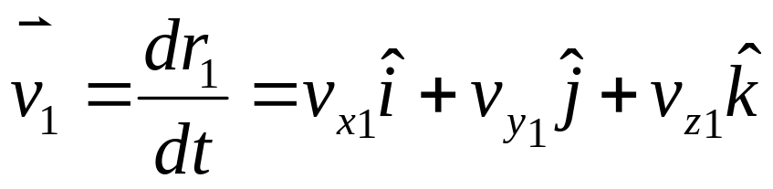

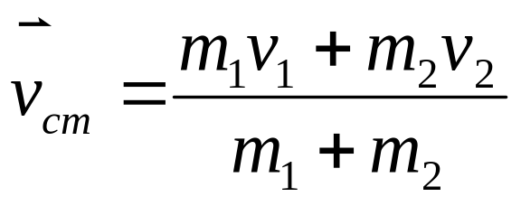
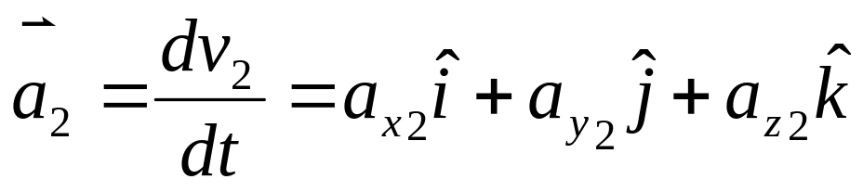
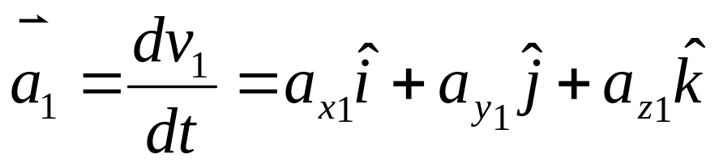
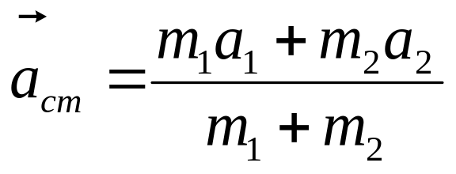
The center of mass
m₂
m₁
Two Particles
One Particle
C
r₁
r₂

Slide 3
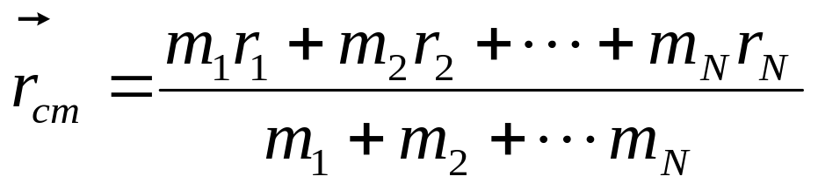
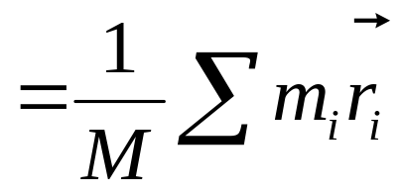
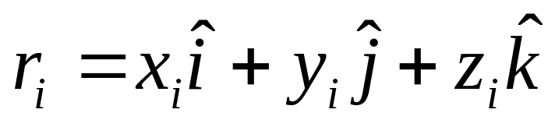
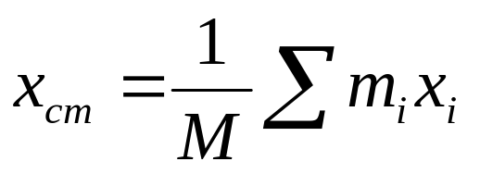
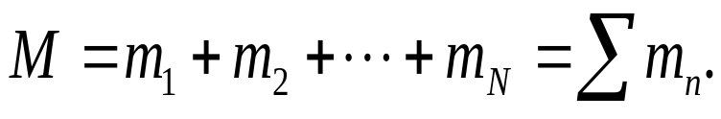

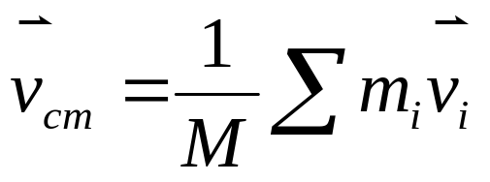
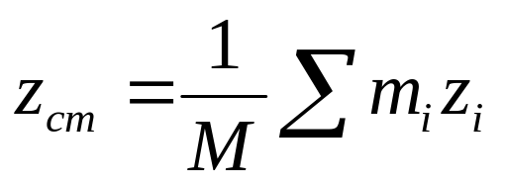
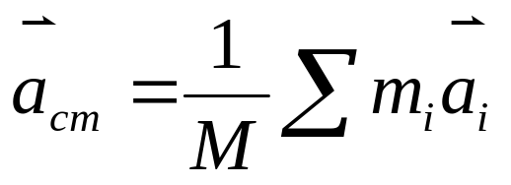
Particles system
The center of mass
Many particles

Slide 4
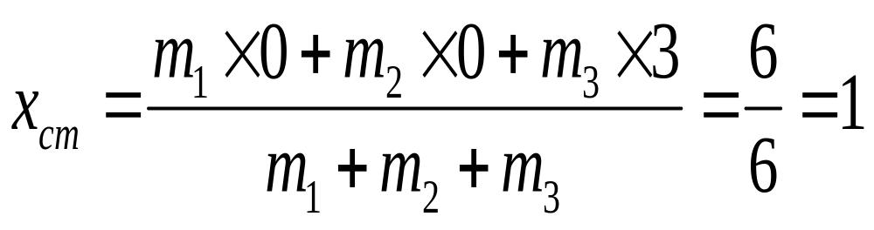

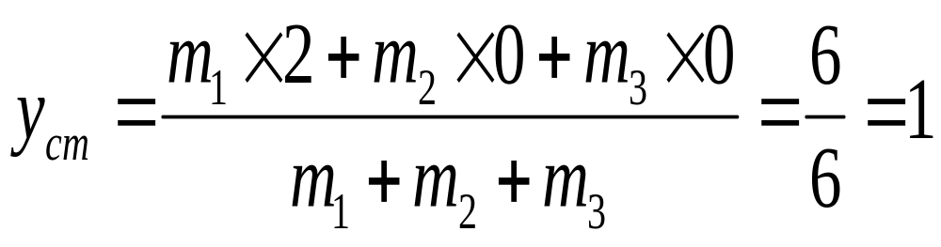
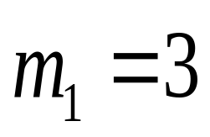


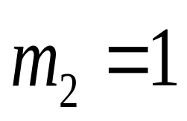

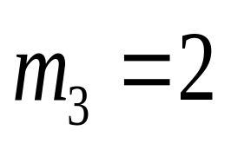
Example
(1,1)
Where is the center of mass?

Slide 5
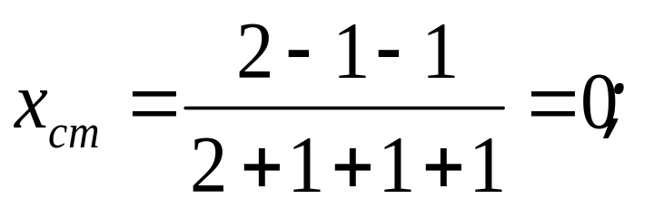

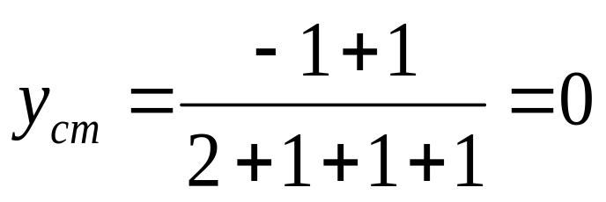

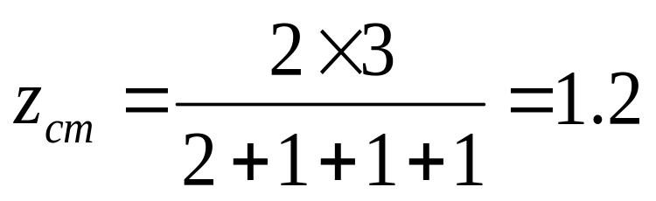

Example
(0,0,3)
(0,0,1.2)
(-1,1,0)
(-1,-1,0)
(2,0,0)
Where is the center of mass?

Slide 6
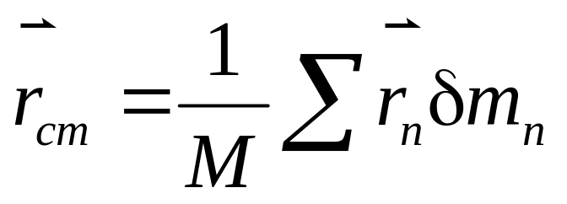

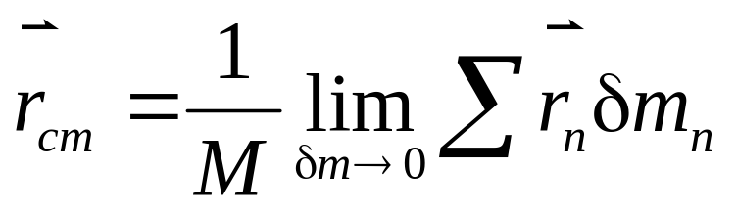
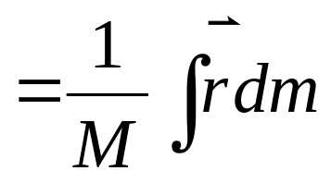
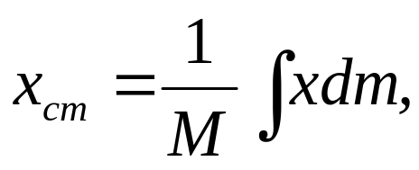
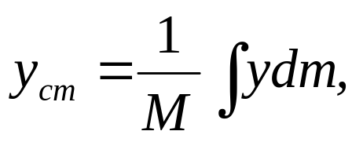
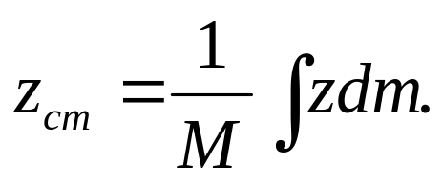
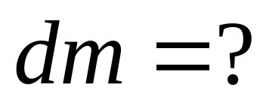
A solid body
(Many articles)
Center of mass of solid objects
δm

Slide 7
dm?
dm=ρdV
solid body
ρ is mass dencity of volume
plane
dm=σdS, σ is mass dencity of plane
line
dm=λdl, λ is mass dencity of line

Slide 8
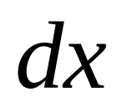



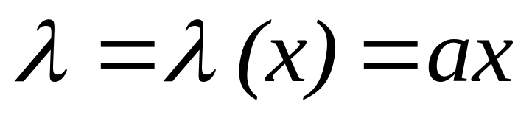
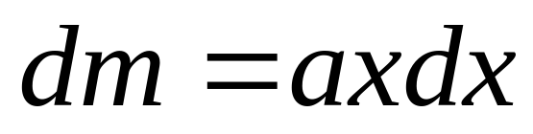
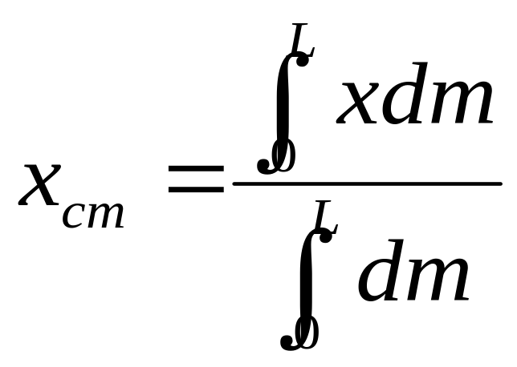
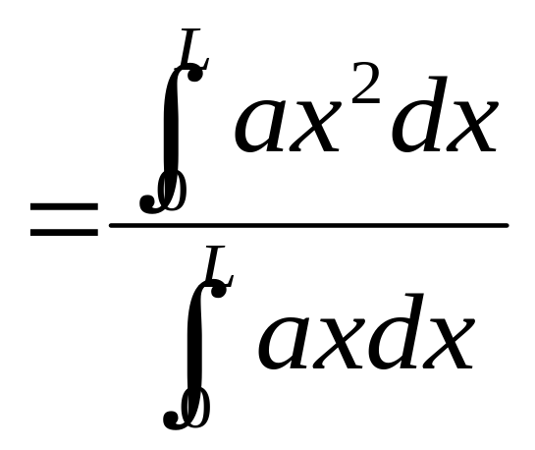
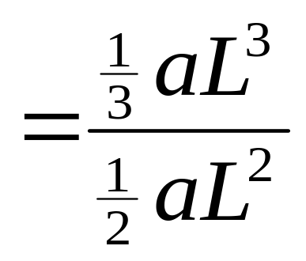
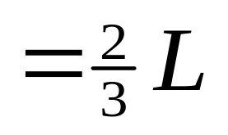
Example

Slide 9
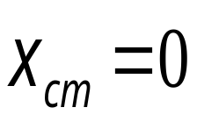

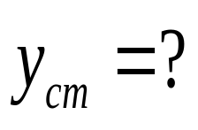
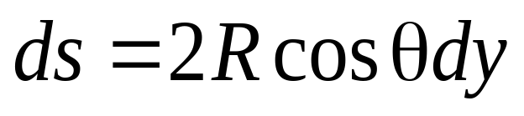

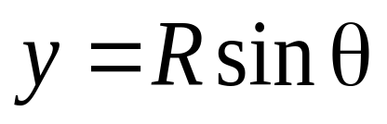
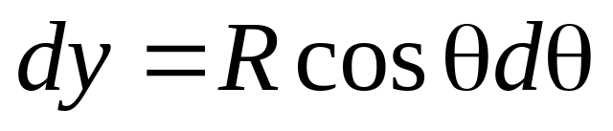

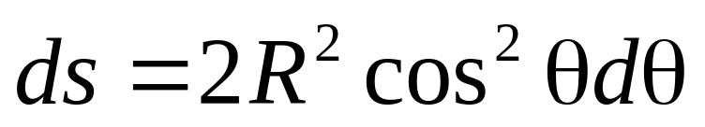
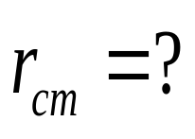
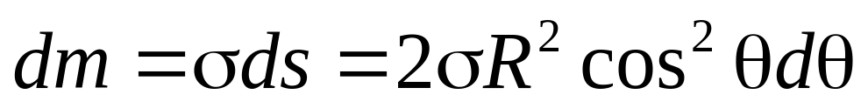




Slide 10
Center of mass of solid objects
+
+
+
+

Slide 11

Center of mass of solid objects

Slide 12
Center of mass of solid objects
Why?
If a irregular objects can be divided into several parts
We can find the center of mass of each part ,
+ c
Treating each part as a particle located at its own center of mass
We can find the center of mass of the combination.

Slide 13









Slide 14





+
+
+

Slide 15



+
+
+

Slide 16







Two-particle systems
F_{ex1}
F_{ex2}
m₁
m₂
F_{in1} F_{in2}
r₁
r₂

Slide 17






Many particles

Slide 18







Conservation of momentum in a system of particles
If ΣF_{ext}=0, the total linear momentum P of the system remains constant. This is the law of conservation of momentum in a system of particles. It can be written as three components formula.

Slide 19










Lab Frame
cm Frame
In the cm frame the total momentum is zero
C
The cm frame called zero momentum reference frame.
m_{i}

Slide 20

Motion of solid body
The motion of mass center
The motion about mass center

Slide 21
Example
m
m
v_{cm}

Slide 22
Example
m
m
v_{cm}

Slide 23
Example
m
m
v_{cm}

Slide 24
Example
m
m
v_{cm}

Slide 25
Example
m
m
v_{cm}

Slide 26



Example
m
m
v_{cm}
The motion of mass center
The motion about mass center

Slide 27
cm Frame
m
m

Slide 28
cm Frame
m
c
m

Slide 29
cm Frame
m
c
m

Slide 30
cm Frame
m
c
m

Slide 31
cm Frame
m
c
m

Slide 32
cm Frame
c
The motion about mass center

Slide 33
CHAP 7
Exercises
11 (P155)
13, 14, 17, 18 (P156)

Slide 34









Systems of variable mass
u
v
v+dv
dM
M
M+dM
time t
time t+dt

Slide 35







Systems of variable mass
If we negligible gravity

Slide 36



To raise the velocity of the spaceship, use multistage rocket.

Slide 37


To raise the velocity of the spaceship, use multistage rocket.

Slide 38






To raise the velocity of the spaceship, use multistage rocket.

Slide 39





Sand dropfrom a stationary hoper at a rate of 0.134 kg/s onto a conveyor belt moving with a speed of 0.96m/s. What net force must be applied to the with a total mass of m₀ is moving from the surface of the conveyor belt to keep it moving at constant speed?
v

